Slide 1
CPS-LAB 1
Let’s break the ice.

Slide 2
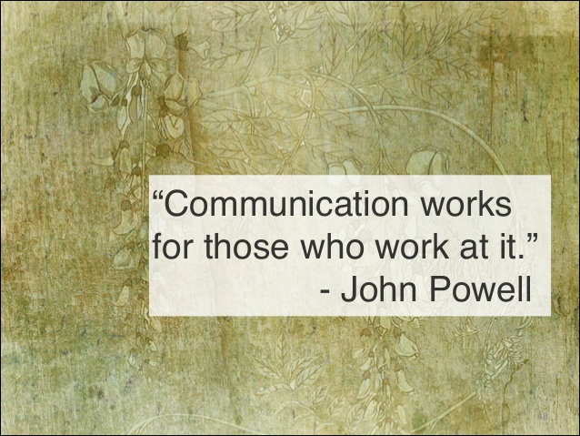
Reflect and Share your thoughts!

Slide 3
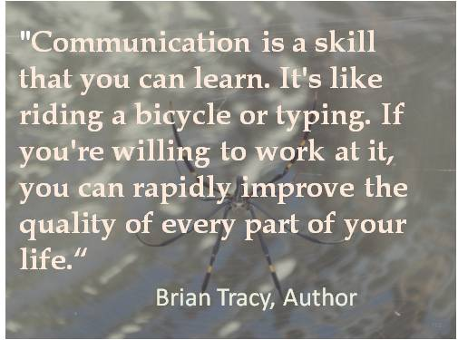
A piece of Advice!

Slide 4
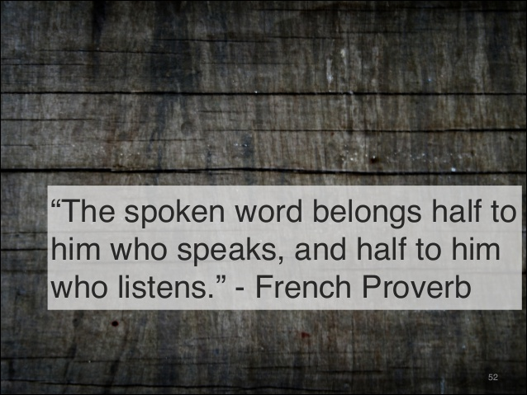
What is the role of listening in Oral Communication?

Slide 5
Listen to the Conversation and do the following?
What are the two speakers talking about?
Who is a better listener?
Who is the better speaker?
What is the best line you would like to use?
Do you use any of these communication skills, such as, friendliness, being very clear, listening with good non-verbal feedback, etc.)

Slide 6

Let’s Get to Know each other!
Now each of you write a list of 5 topics you would like to speak about (some suggestions are your favorite movie, your hobbies, how much time do you spent on social media and what do you actually do, discuss any show you have seen recently if it is decent for the classroom, etc.)
Now, let me divide you in pairs.
Ok, now give your list of topics to your partner. Let him/her select any one topic and talk about it for 1 to 2 minutes only.
Ok, now your job is to listen to your partner attentively and summarize his/her answer in front of the class.
The class will tell how good a listener you are.
Now you can speak on any one topic from your partner’s list and let’s see how good a listener your partner is.

Slide 7

Final Take Away!
Communication should not be taken for granted.
It is an art and science that needs to be studied and practiced.
Good speakers and listeners you meet are your constant source of inspiration and learning.
Gear up for mastering tried and test communication skills in the business world (they will be fully applicable to personal life as well).

